Slide 1
Statistical Analysis
Hypothesis Testing

Slide 2
Hypothesis Testing
What is a hypothesis?
“In statistics a hypothesis is a claim about some property of a population”
% of people listening to RTE1 has dropped over the last six months

Slide 3
More examples
Mean weight of all bags of crisps packaged by a company is 250g
35% of the constituency will support me when I run for election

Slide 4
Legal System
The legal system states that a prisoner is innocent until proven guilty.
The prisoner is bought to court and tried.
Evidence is presented
Based on that evidence a prisoner is judged as guilty or not guilty.
The evidence has to be very strong for the defendant to be judged guilty.
Defendant has to be guilty beyond reasonable doubt.

Slide 5
Hypothesis framework
We set up two competing hypotheses:
H1: Defendant is innocent
H2: Defendant is guilty
Assume defendant is innocent and look at the evidence e.g. forensic evidence and testimony of various people
The jury has to decide on the basis of the evidence if a prisoner is guilty beyond reasonable doubt.
Very similar to what happens in Statistical Hypothesis Testing

Slide 6
Statistical Hypothesis testing
We set up competing hypotheses
Null Hypothesis commonly denoted as H₀
Alternative hypothesis (H₁)
.

Slide 7
Null Hypothesis
A straw person which we want to knock down
We are not interested in proving this hypothesis but in disproving it.
It has to be worth disproving.
Usually states that some parameter in a population is equal to another parameter or a particular value.
% of population listening to Radio 1 at both time periods are the same

Slide 8
Null Hypothesis
Besides being a worthwhile hypothesis it has to be testable from a statistical point of view.
We then use our data to choose between the two competing hypotheses in a very particular manner.

Slide 9
Process
The data in statistics play the role of the evidence in court.
We assume that the null hypothesis is true and evaluate the data in that light.
We end up with an actual probability of getting our data (or more extreme) given that the null hypothesis is true

Slide 10
More on Process
This probability is the p-value printed out by statistical programs.
Very small p-values correspond to evidence against Null Hypothesis
How small is small?
Small is less < .05 – called the significance value (α)
Like the judicial situation we need a lot of evidence against the null hypothesis.

Slide 11
More on Process
How do we calculate this probability p?
We carry out statistical tests that result in this probability p
We can also carry out this process using confidence intervals

Slide 12
Which Statistical test?
The question now is what test statistic to use
This depends on the form of the null hypothesis, the type of data and the story behind the data

Slide 13
Simple Hypothesis
Mean weight of all bags of crisps packaged by a company is 250g
Null Hypothesis H₀: µ = 250g
Alternative Hypothesis H₁: µ ≠ 250g
Sample of 50 bags and weigh them
Have to make a decision.
Variation between bags

Slide 14
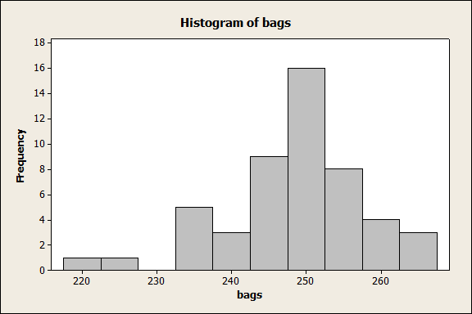
Graph the data
Mean = 248.40 grams SD: 8.98 n=50

Slide 15
Test statistic
n is the sample size
sd is an estimate of the variation in the population
µ₀ is the population mean (H₀ value)
We estimate the population sd by the sample sd
Z is distributed as a N(0,1) distribution - theory

Slide 16
Test Statistic again
How likely are we to get a sample mean of 248.40 from
a population where the mean = 250 where sd=8.98 and
n=50?
Sample means are normally distributed
SD of this distribution =

Slide 17
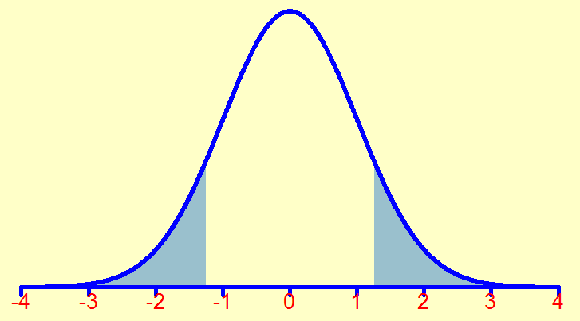
What is extreme?

Slide 18
Look up normal tables
Most extreme corresponds to area to the left of -1.26 and to the right of 1.26 – blue area
This equals = 2*(1-0.90)= 0.20
There is a probability of 0.20 of getting our data or a more extreme value if the null hypothesis is true
This is greater than 0.05
We do not have enough evidence to reject H₀

Slide 19
Another approach
Instead of comparing values on the p-value scale.
We can compare values on the z-scale
We can convert our significance value α to a z-value
p=0.05 is equivalent to a cutoff value of 1.96
So we calculate our test statistic z as before
We reject H₀ for values of z < -1.96 or z > 1.96
Values between -1.96<z<1.96 – no evidence to reject the H₀

Slide 20
Our example
We got z=1.26 which is inside the interval
[-1.96,1.96]
No evidence to reject H₀

Slide 21
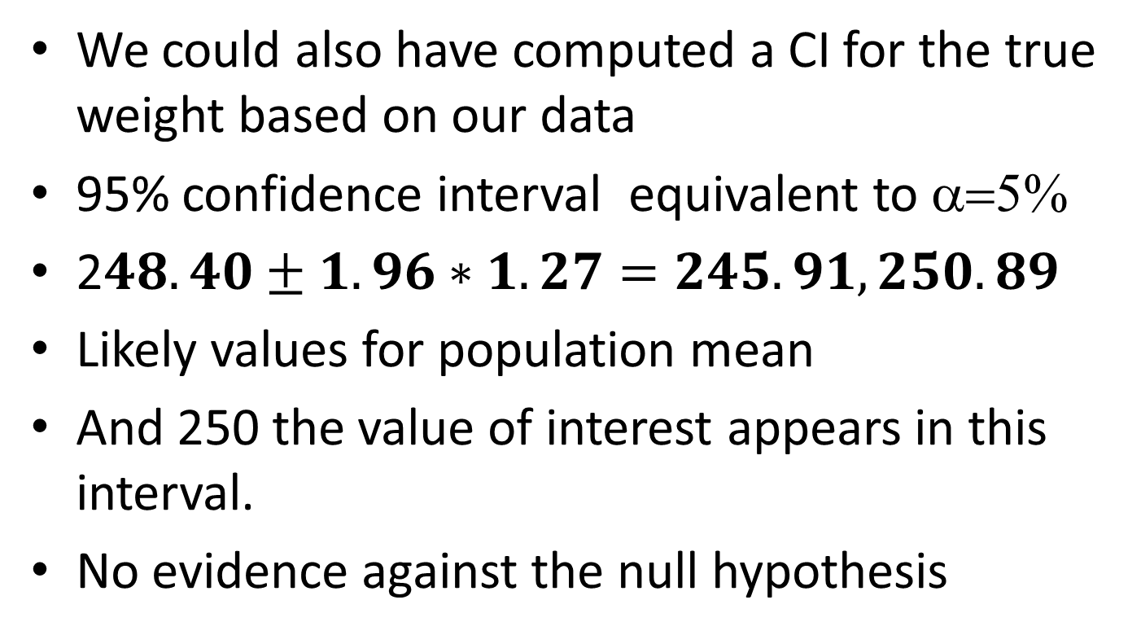
Relationship with Confidence intervals
We could also have computed a CI for the true weight based on our data
95% confidence interval equivalent to α=5%
2$48.40±1.96∗1.27=245.91, 250.89$
Likely values for population mean
And 250 the value of interest appears in this interval.
No evidence against the null hypothesis

Slide 22
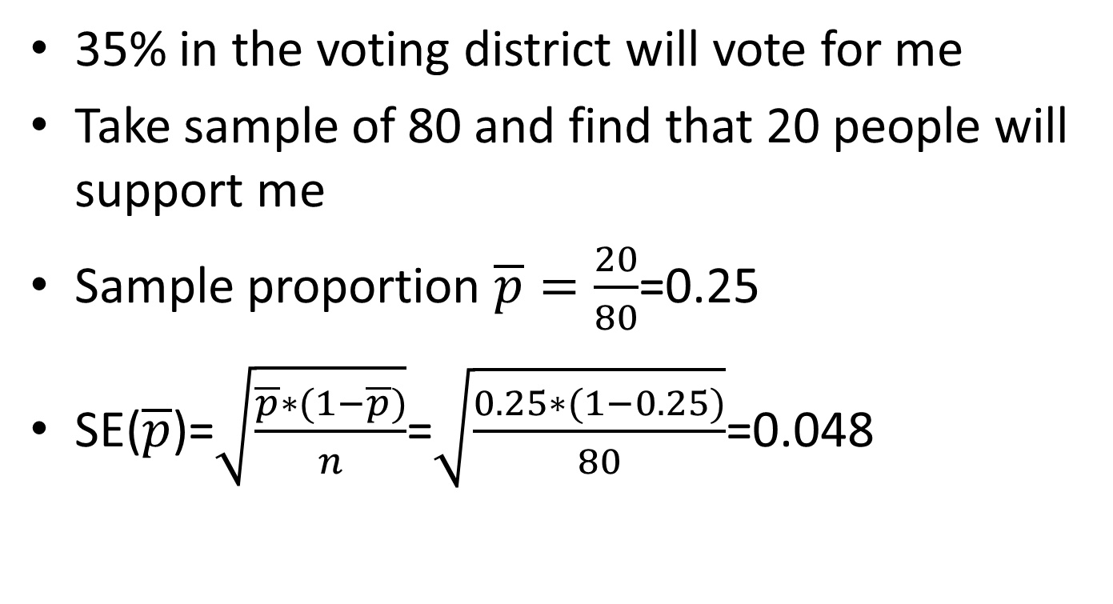
Second example
35% in the voting district will vote for me
Take sample of 80 and find that 20 people will support me
Sample proportion $\overline{p}=\frac{20}{80}$=0.25
SE($\overline{p}$)=$\sqrt{\frac{\overline{p}∗(1−\overline{p})}{n}}$=$\sqrt{\frac{0.25∗(1−0.25)}{80}}$=0.048

Slide 23
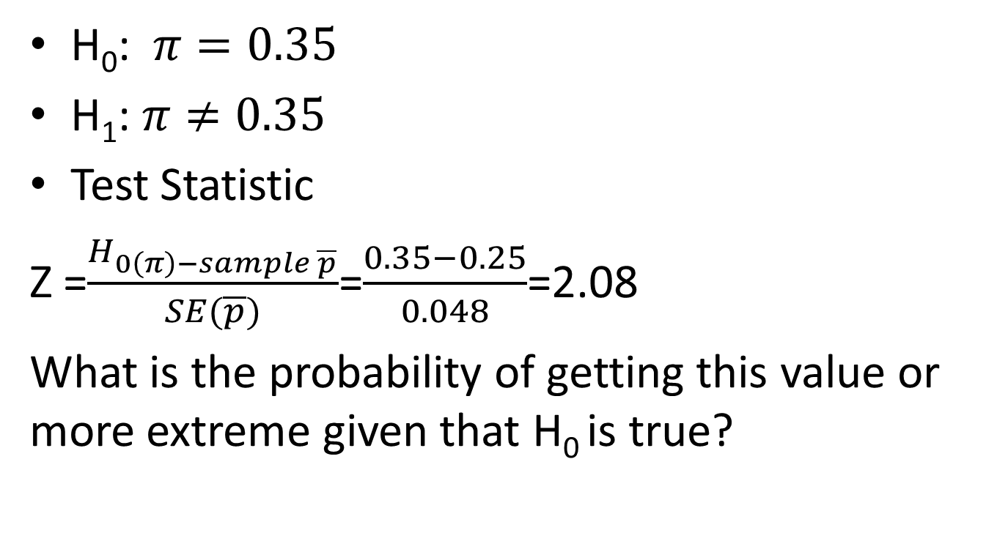
And again …
H₀: $π=0.35$
H₁: $π≠0.35$
Test Statistic
Z =$\frac{H_{0\left(π\right)−sample \overline{p}}}{SE(\overline{p})}$=$\frac{0.35−0.25}{0.048}$=2.08
What is the probability of getting this value or more extreme given that H₀ is true?

Slide 24
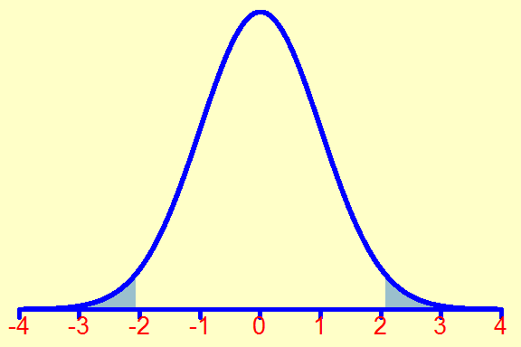
A little graph

Slide 25
Look up normal tables
Most extreme corresponds to area to the left of -2.08 and to the right of 2.08 – blue area
This equals = 2*(1-0.98)= .04
There is a probability of 0.04 of getting our data or a more extreme value if the null hypothesis is true
This is less than 0.05
We do have enough evidence to reject H₀

Slide 26
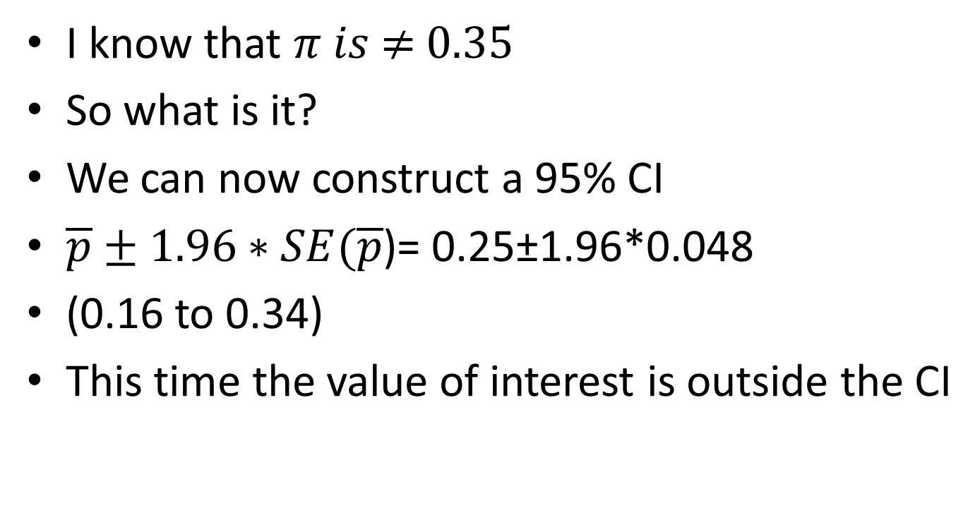
What next
I know that $π is \text{≠}\text{ 0.35}$
So what is it?
We can now construct a 95% CI
$\overline{p}±1.96∗SE(\overline{p}$)= 0.25±1.96*0.048
(0.16 to 0.34)
This time the value of interest is outside the CI

Slide 27
Summary of steps
Examine data
Descriptive Statistics
Formulate Hypotheses
Test hypothesis
If significant provide an appropriate confidence interval
If not ????

